Slide 1



Mental Health Prediction Using Machine Learning
Guide name:Mrs.M.R.NITHYA,M.E.,
Submitted by
ARTHY M (8115U22CB007)
REENA S (8115U22CB044)
SHREE HARINI S (8115U22CB050)
SOUNDARYA AL (8115U22CB052)

Slide 2
Machine learning
Machine learning is a subfield of artificial intelligence, which is broadly defined as the capability of a machine to imitate intelligent human behavior.
Artificial intelligence systems are used to perform complex tasks in a way that is similar to how humans solve problems.
machine learning enables computers to learn from data and make decisions or predictions without being explicitly programmed to do so.
Types: supervised, semi-supervised, unsupervised and reinforcement.

Slide 3
Abstract
Machine learning, a subset of artificial intelligence, can play a crucial role in detecting mental illnesses. This project proposes using the decision tree classifier algorithm to identify mental health conditions like anxiety, depression, and panic attack by analyzing recorded student datasets. The goal is to create a training model that can predict the target variable class. Additionally, the random forest algorithm is applied to predict mental illnesses, resulting in a more accurate prediction level compared to existing models. This research aims to provide an ideal solution for detecting mental health conditions based on gender and based on students course using machine learning algorithms.

Slide 4

Introduction
Mental health prediction using machine learning is the process of using computer algorithms to analyze data and identify patterns that can help predict the onset or severity of mental health conditions like depression , anxiety and panic attack.
This allows for earlier detection and more personalized treatment options.
Key Components
Students Data Collection
Feature Extraction
Machine Learning Models
Prediction and comparison

Slide 5
Problem Statement
Develop a training model to predict mental health conditions with high accuracy .Compare the performance of decision tree classifier and random forest algorithms. Identify key factors contributing to mental health conditions .Design a user-friendly interface for data input and result interpretation. Evaluate the model's effectiveness in detecting mental health conditions.
Mental health conditions such as anxiety, depression, and panic attack are increasingly prevalent, affecting millions worldwide students. Current diagnostic methods rely heavily on manual assessments, which can be subjective, time-consuming, and often lead to delayed interventions. Existing machine learning models for mental health prediction lack accuracy, scalability, and user-friendliness.

Slide 6
Literature review
TOPIC | AUTHOR & YEAR OF PUBLICATION | ALGORITHM | DIADVANTAGES
A machine learning algorithm to differentiate bipolar disorder from major depressive disorder using an online mental health questionnaire and | Tomasik et al. Translational Psychiatry (2021) | Decision tree,Support vector machine,logistic regression ,random forest,linear regression,K nearest neighbour | Data Privacy Concerns Ethical Concerns
Application of Machine Learning Methods in Mental Health Detection: A Systematic Review | ROHIZAH ABD RAHMAN 1 (2020) | Machine learning algorithm with deep learning technique | Lack of standardization Rapidly evolving field
Judging Mental Health Disorders Using Decision Tree models | Sandip Roy , P. S. Aithal , Rajesh Boseh (2021) | Decision tree | Overfitting Bias Sensitivity
Employing Artificial Intelligence Techniques in | Rozita Yati Masri, Hajar Mat Jani (2012) | Fuzzy genetic algorithm, | Data Dependency Trust issues
Prediction of Mental Health Problems Among Children Using Machine Learning Techniques | Ms. Sumathi M.R., Research Scholar (2016) | Multilayer perception,multiclass classifier and LAD tree | Limited Data Availability Data sensitivity

Slide 7
Existing System
1. Psychosis Prediction System: Utilizes MRI scans and ML algorithms to predict psychosis onset.
2. Mental Health Screening Tool (MHST): Employs natural language processing (NLP) and ML to identify mental health risks.
3. Predictive Analytics for Mental Health (PAMH): Analyses electronic health records (EHRs) to predict mental health outcomes.
4. Mental Health Forecast (MHF): Uses social media data and ML to predict depression and anxiety.
5. Clinical Decision Support System (CDSS): Integrates ML with EHRs to predict mental health diagnoses.

Slide 8
Disadvantages of existing system
Limited contextual understanding: ML models may not fully understand the complexities of human behavior, emotions, and social context.
Data quality issues: Poor data quality, bias, or incomplete information can lead to inaccurate predictions.
Patient privacy concerns: Using sensitive personal data for ML predictions raises privacy and confidentiality concerns.
Continuous updating and maintenance: ML models require regular updating and maintenance to ensure accuracy and relevance.
Regulatory and ethical challenges: There is a need for clear guidelines and regulations on developing and deploying ML-based mental health prediction systems.

Slide 9
PROPOSED SYSTEM
The proposed system uses machine learning to predict mental health conditions, specifically depression. The dataset is pre-processed to remove noise and irrelevant data and split into training and testing sets. Machine learning algorithms, like Decision Tree and Random Forest, are applied to build a predictive model. The best-performing model is selected based on its accuracy, ensuring reliable predictions. This system bridges the gap between traditional mental health assessments and efficient, data-driven solutions.
Algorithms Used:
Decision Tree: Builds a simple tree structure by splitting data into subsets based on feature values, providing interpretable classification results.
Random Forest: Combines multiple decision trees to improve accuracy and reduce overfitting, ensuring robust predictions.

Slide 10
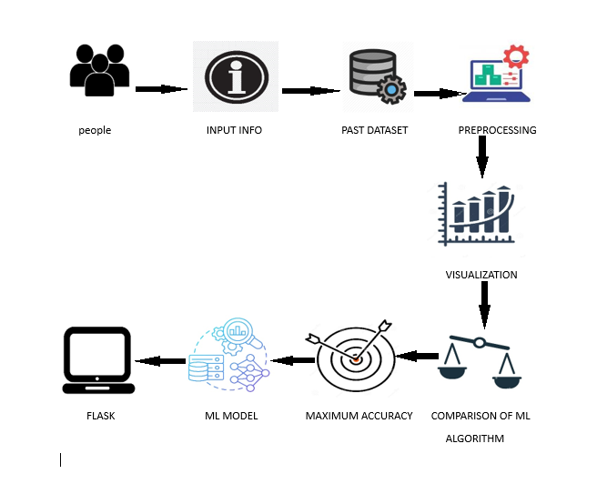
SYSTEM ARCHITECTURE

Slide 11
MODULE LIST
MODULE LIST
Data cleaning
Extension: Random Forest and Decision Tree Accuracy Calculation
Prediction by gender
Model Generation
Splitting Data into Train & Test Sets
Data Exploration
Prediction by students course
Result

Slide 12
MODULE DESCRIPTION
Data Exploration
This module involves loading the dataset from sources like CSVs or databases and performing an initial analysis to understand the data's structure and distribution.
Key statistics (mean, standard deviation) are calculated, and data visualizations (e.g., bar graph, strip plots) are generated to identify trends, outliers, and missing values.
2)Data Cleaning
This processing of fixing or removing incorrect, corrupted,incorrectly formatted, duplicated or imcomplete data within a dataset .
3)Splitting Data into Train & Test Sets:
This module splits the dataset into training and testing sets (e.g., 80% train, 20% test) to evaluate model performance.
Using tools like train test split, the split can be stratified to maintain class distribution across both sets for balanced training and testing.
Model Generation:
Machine learning models such as Decision Trees and Random Forests are trained in this module.
The models are built using the training data, with hyperparameter tuning and cross-validation to ensure accuracy and robust performance.

Slide 13
Extension: Random Forest and Decision Tree Accuracy Calculation
This module, the performance of the trained models (Random Forest and Decision Tree) is evaluated using metrics like accuracy, precision, recall, and F1-score.
Confusion matrices are generated to visualize classification performance, and the better model is determined based on accuracy and evaluation metrics.
6) Prediction by gender
Machine learning algorithm can be trained to predict mental health outcomes separately for males and females, taking into account these gender specific difference.
7) Prediction by students course
Machine learning algorithms can be trained to predict mental health outcomes in students based on this data. Diffrent courses, such as engineering, Bsc, law,nursing,MBBS may have unique characteristics that affect students ‘mental health’.
8) Result
Random forest algorithm outperforms the Decision tree algorithm in terms of accuracy. The random forest algorithms ability to capture complex relationships between features and reduce overfitting contributes to its higher accuracy.

Slide 14
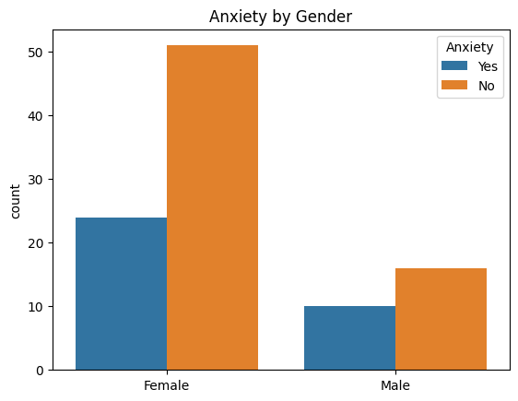
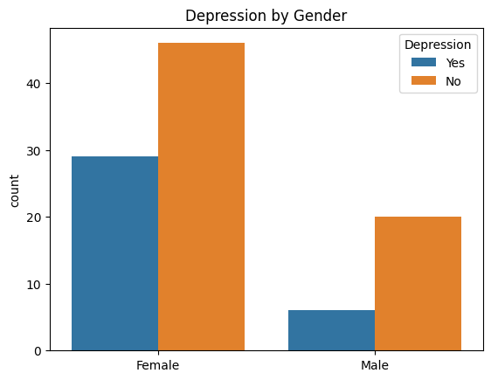
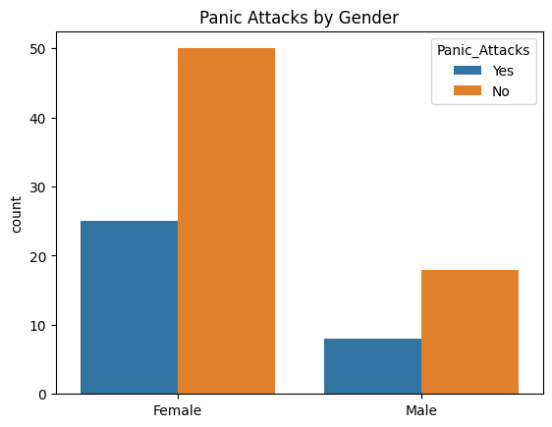
Output by gender

Slide 15
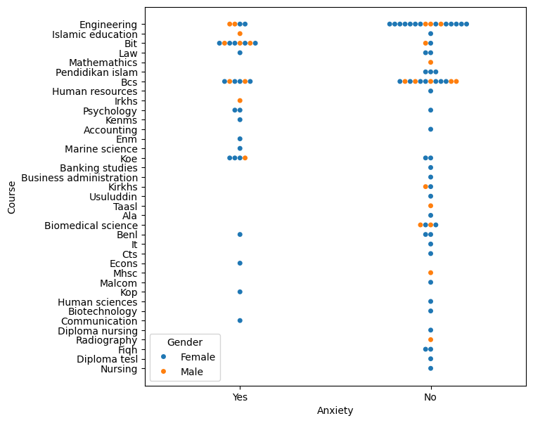
Output by students course

Slide 16
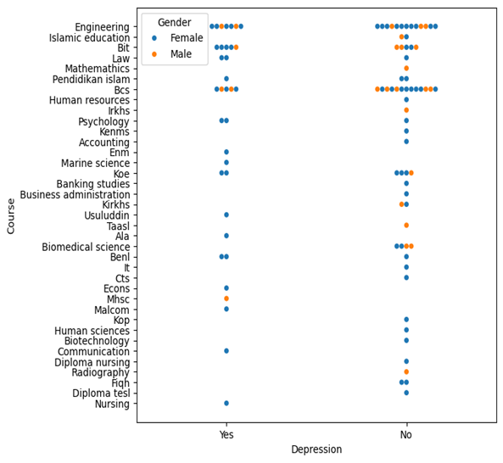

Slide 17
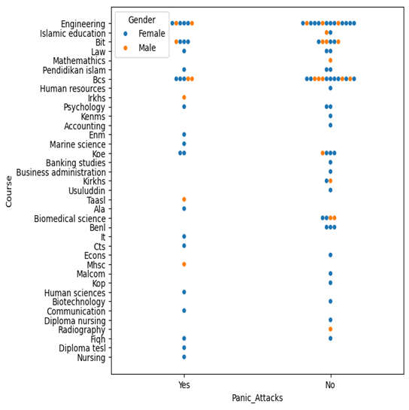

Slide 18
CONCLUSION
This project demonstrates the potential of machine learning algorithms, specifically Decision Tree and Random Forest classifiers, to predict mental health conditions such as anxiety, depression, and panic attack with accuracy and reliability. By leveraging real-world survey data from diverse sources, this approach highlights how predictive models can aid in identifying individuals at risk and supporting early intervention. Using Google Colab as the development platform, we implemented a workflow that included data preprocessing , feature engineering, model training, and evaluation. Google Colab's robust environment allowed us to efficiently utilize GPU resources for faster computation, integrate interactive visualizations, and streamline the collaboration and deployment process.

Slide 19
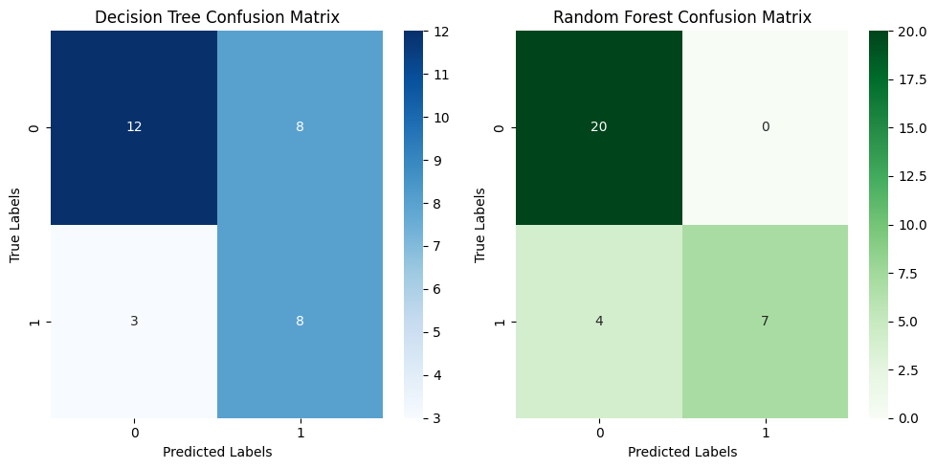
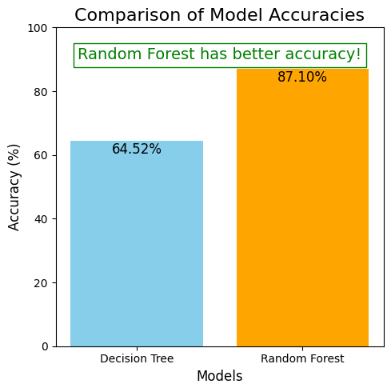
RESULT
Random forest algorithm outperformed the decision tree algorithm in predicting mental health outcomes. The Random Forest algorithm achieved an accuracy of 87.10%, while the Decision tree algorithm an accuracy of 64.52%.

Slide 20
Thank You

